Slide 1
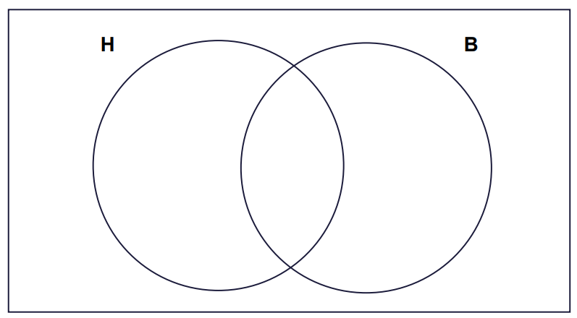




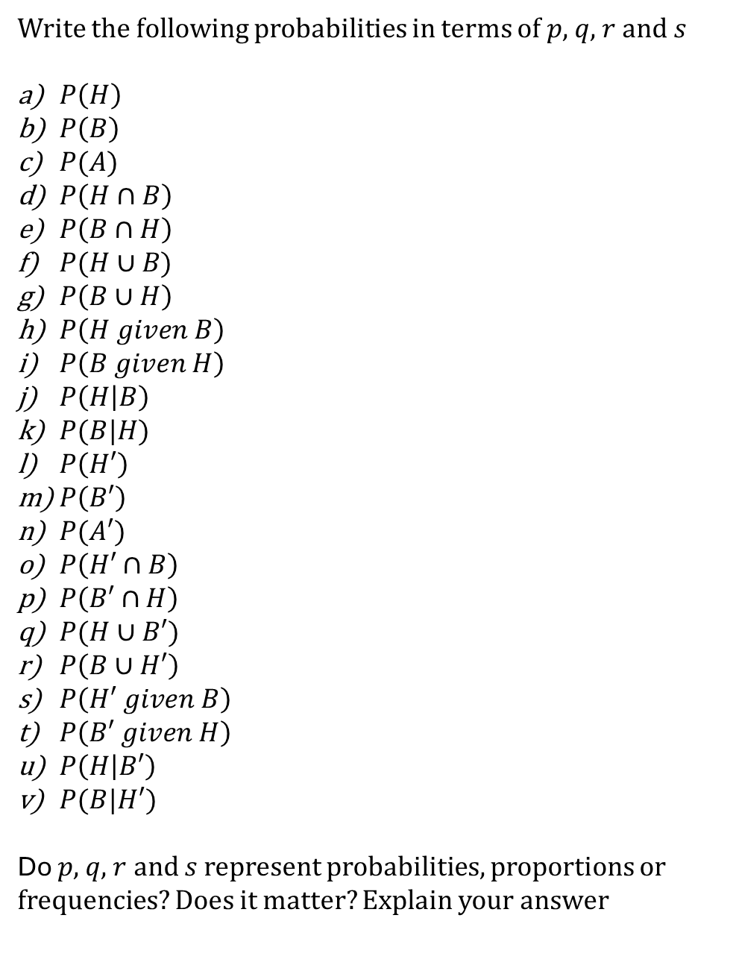








$$p$$
$$q$$
$$r$$
$$s$$
Write the following probabilities in terms of $p$, $q$, $r$ and $s$
$P\left(H\right)$
$P\left(B\right)$
$P(A)$
$P\left(H∩B\right)$
$P\left(B∩H\right)$
$P(H∪B)$
$P\left(B∪H\right)$
$P\left(H given B\right)$
$P\left(B given H\right)$
$P\left(H | B\right)$
$P(B|H)$
$P\left(H′\right)$
$P\left(B′\right)$
$P(A′)$
$P\left(H′∩B\right)$
$P\left(B′∩H\right)$
$P(H∪B′)$
$P\left(B∪H′\right)$
$P\left(H′ given B\right)$
$P\left(B′ given H\right)$
$P\left(H | B′\right)$
$P(B|H′)$
Do $p$, $q$, $r$ and $s$ represent probabilities, proportions or frequencies? Does it matter? Explain your answer
Challenge:
Find all the probabilities for the Venn Diagram below
H
$$0.1$$
$$p$$
B
$$q$$
$$s$$
A
$$r$$
$$0.2$$
$$\frac{1}{20}$$
$$0.1$$

Slide 2
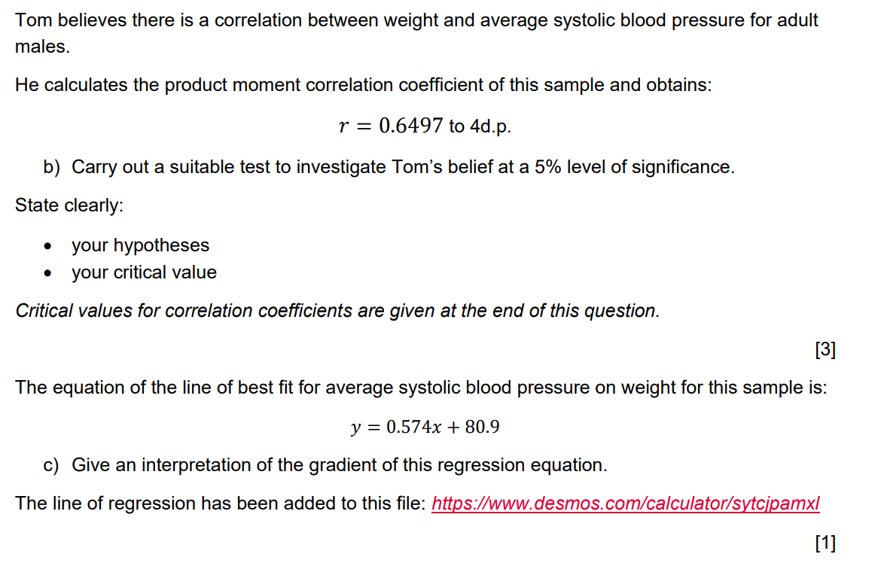
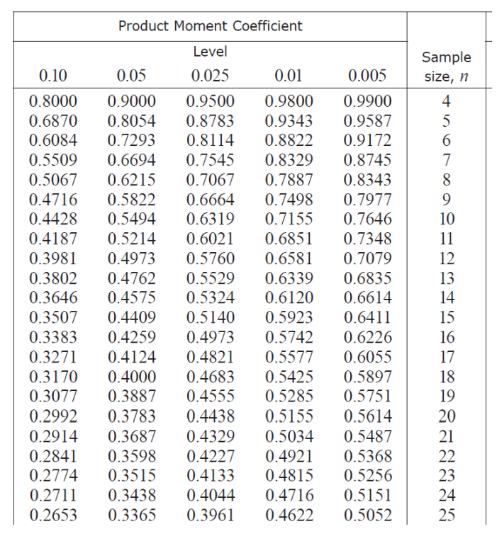
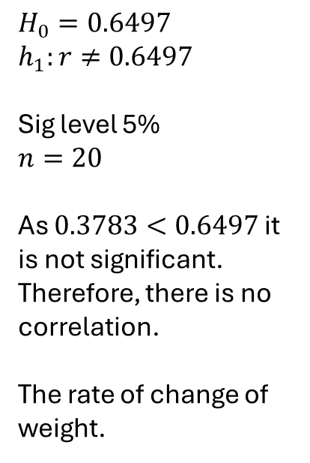
b)
$$H_{0}=0.6497$$
$$h_{1}:r≠0.6497$$
Sig level 5%
$$n=20$$
As $0.3783<0.6497$ it is not significant. Therefore, there is no correlation.
The rate of change of weight.
c)
Spot all the mistakes in the students answer

Slide 3
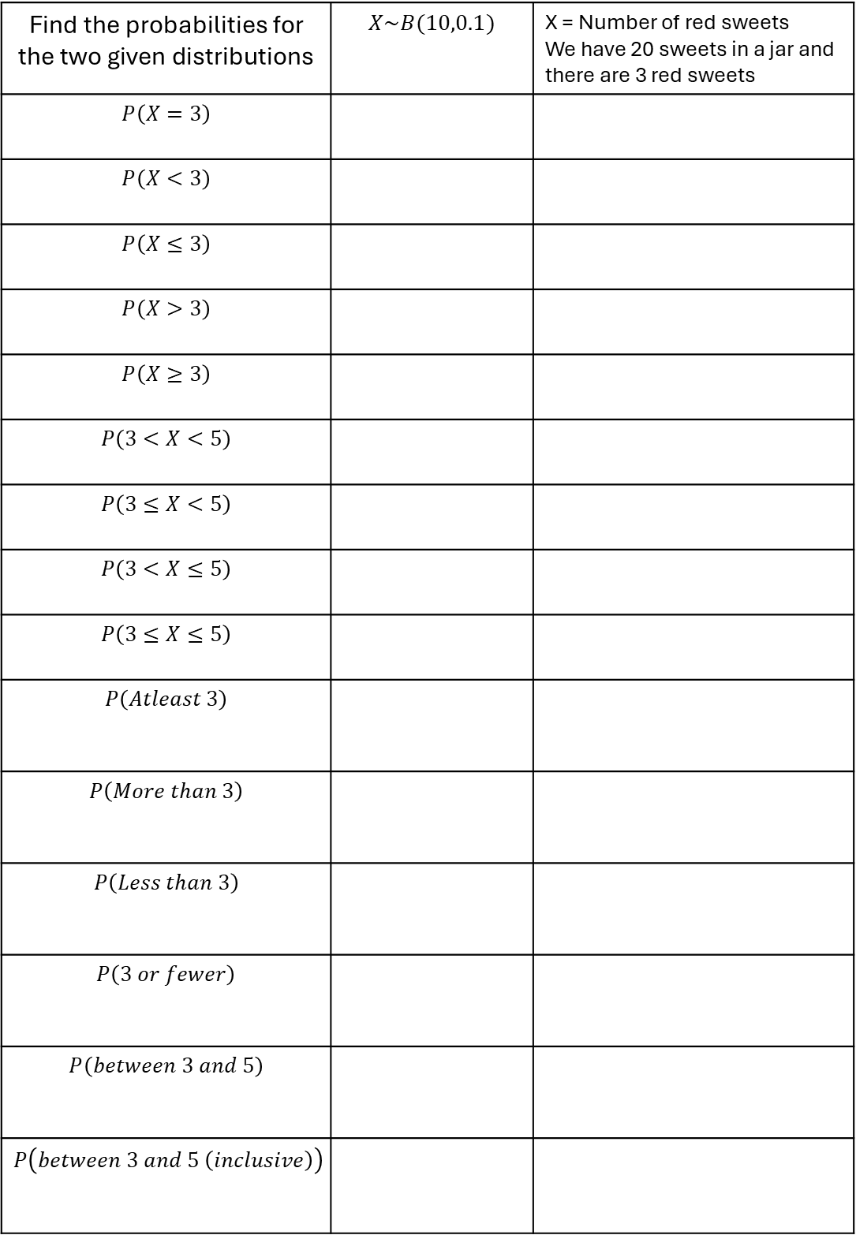
Find the probabilities for the two given distributions | $$X\sim B(10,0.1)$$ | X = Number of red sweets We have 20 sweets in a jar and there are 3 red sweets
$$P\left(X=3\right)$$
$$P\left(X<3\right)$$
$$P\left(X≤3\right)$$
$$P\left(X>3\right)$$
$$P\left(X≥3\right)$$
$$P\left(3<X<5\right)$$
$$P\left(3≤X<5\right)$$
$$P\left(3<X≤5\right)$$
$$P\left(3≤X≤5\right)$$
$$P\left(Atleast 3\right)$$
$$P\left(More than 3\right)$$
$$P\left(Less than 3\right)$$
$$P\left(3 or fewer\right)$$
$$P\left(between 3 and 5\right)$$
$$P\left(between 3 and 5 \left(inclusive\right)\right)$$

Slide 4
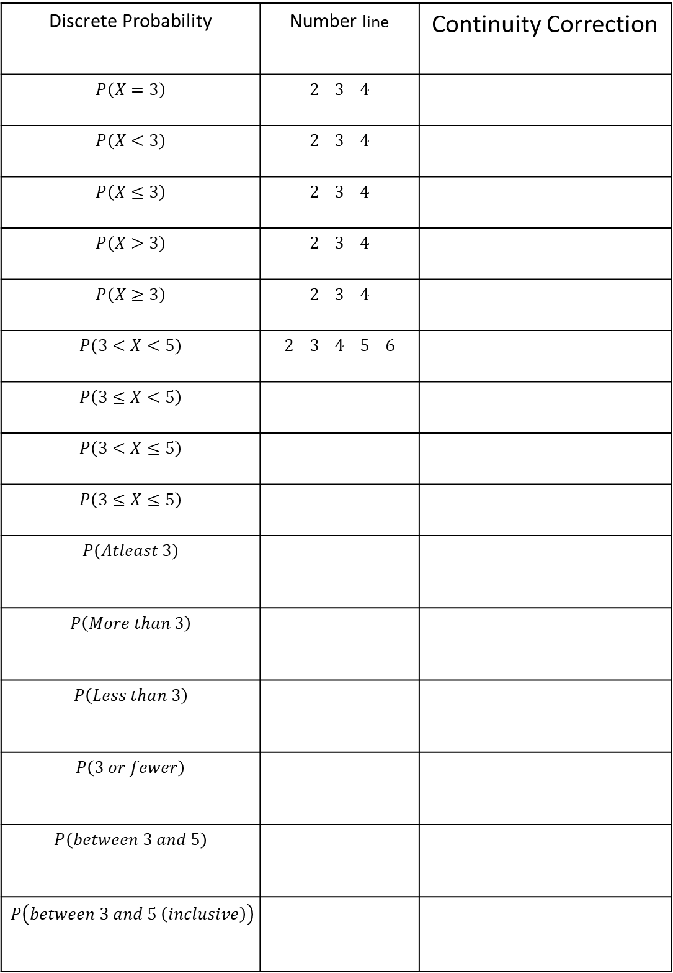
Discrete Probability | Number line | Continuity Correction
$$P\left(X=3\right)$$ | $$2 3 4$$
$$P\left(X<3\right)$$ | $$2 3 4$$
$$P\left(X≤3\right)$$ | $$2 3 4$$
$$P\left(X>3\right)$$ | $$2 3 4$$
$$P\left(X≥3\right)$$ | $$2 3 4$$
$$P\left(3<X<5\right)$$ | $2 3 4 5 6$
$$P\left(3≤X<5\right)$$
$$P\left(3<X≤5\right)$$
$$P\left(3≤X≤5\right)$$
$$P\left(Atleast 3\right)$$
$$P\left(More than 3\right)$$
$$P\left(Less than 3\right)$$
$$P\left(3 or fewer\right)$$
$$P\left(between 3 and 5\right)$$
$$P\left(between 3 and 5 \left(inclusive\right)\right)$$

Slide 5
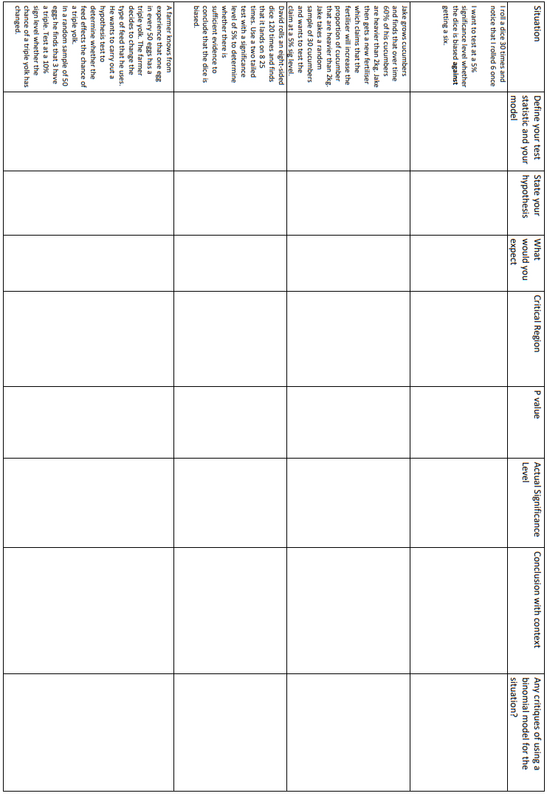

Slide 6
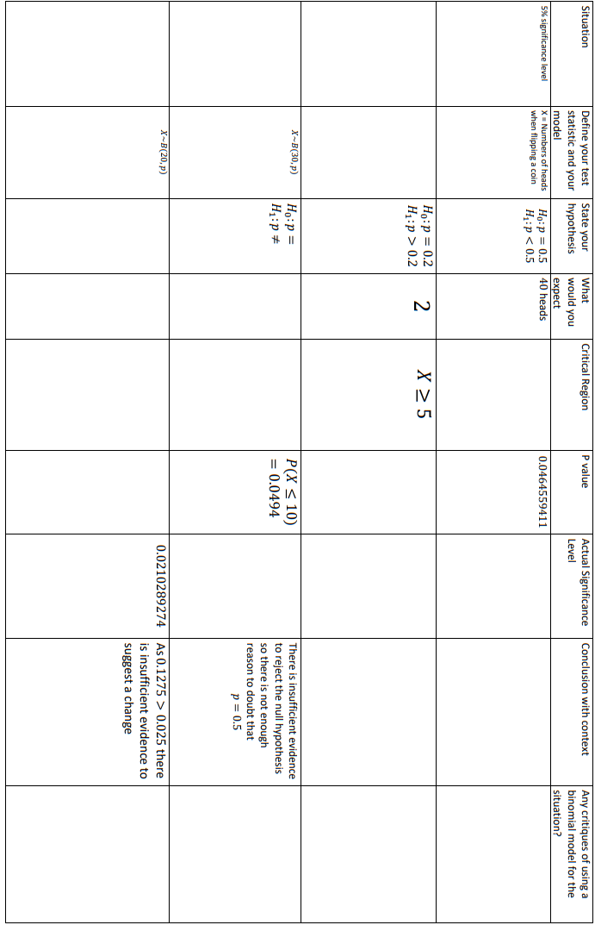

Slide 7
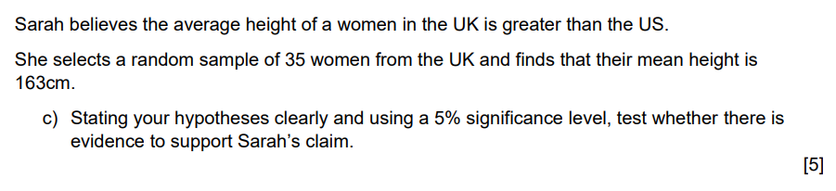
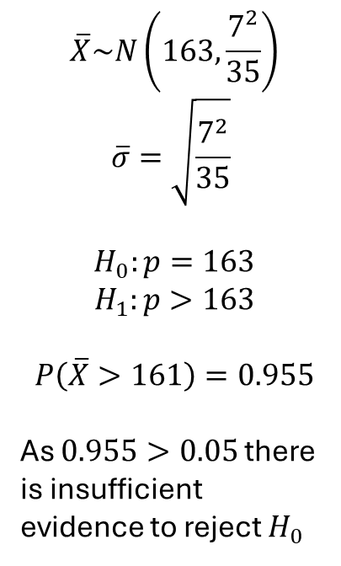
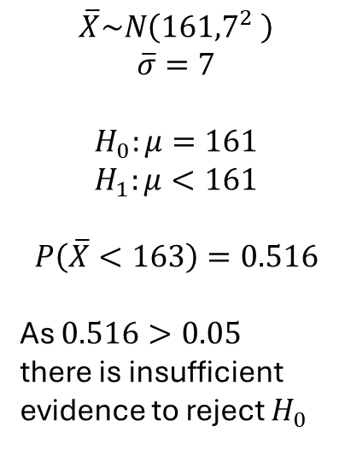
Spot all the mistakes in each of these students’ answers
The standard deviation is found to be 7
$$\overline{X}\sim N\left(163,\frac{7^{2}}{35}\right)$$
$$\overline{σ}=\sqrt{\frac{7^{2}}{35}}$$
$$H_{0}:p=163$$
$$H_{1}:p>163$$
$$P\left(\overline{X}>161\right)=0.955$$
As $0.955>0.05$ there is insufficient evidence to reject $H_{0}$
$$\overline{X}\sim N\left({161,7}^{2} \right)$$
$$\overline{σ}=7$$
$$H_{0}:μ=161$$
$$H_{1}:μ<161$$
$$P\left(\overline{X}<163\right)=0.516$$
As $0.516>0.05$
there is insufficient evidence to reject $H_{0}$

Slide 8
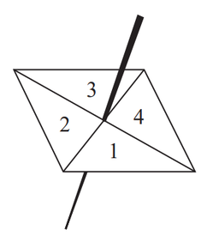
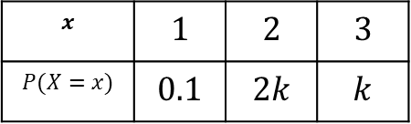
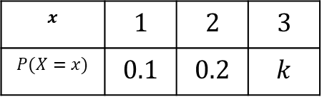
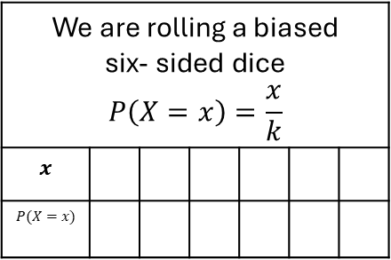
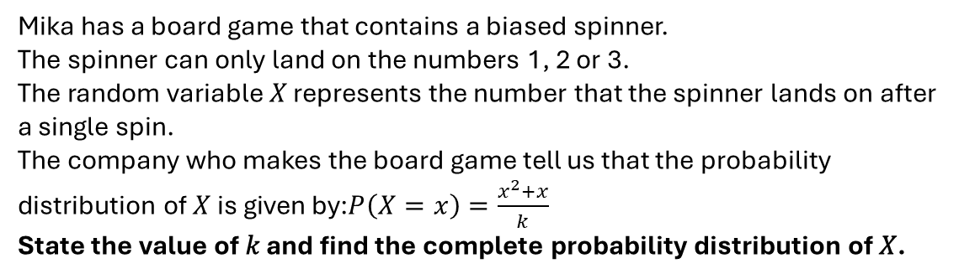
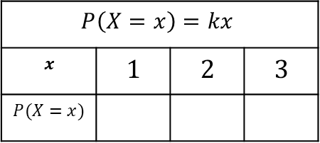
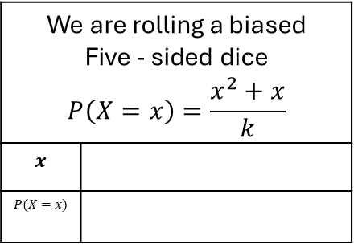
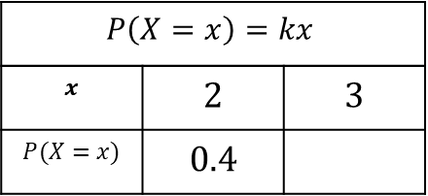
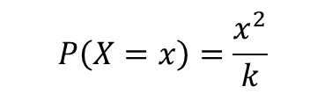
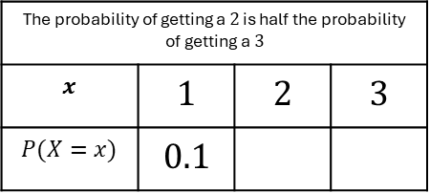
Find the value of $k$ for each of the following probability distributions
$$x$$ | $$1$$ | $$2$$ | $$3$$
$$P(X=x)$$ | $$0.1$$ | $$0.2$$ | $$k$$
$$x$$ | $$1$$ | $$2$$ | $$3$$
$$P(X=x)$$ | $$0.1$$ | $$2k$$ | $$k$$
The probability of getting a $2$ is half the probability of getting a $3$
$$x$$ | $$1$$ | $$2$$ | $$3$$
$$P(X=x)$$ | $$0.1$$
$$P\left(X=x\right)=kx$$
$$x$$ | $$1$$ | $$2$$ | $$3$$
$$P(X=x)$$
$$P\left(X=x\right)=kx$$
$$x$$ | $$2$$ | $$3$$
$$P(X=x)$$ | $$0.4$$
We are rolling a biased six- sided dice $$P\left(X=x\right)=\frac{x}{k}$$
$$x$$
$$P(X=x)$$
We are rolling a biased Five - sided dice $$P\left(X=x\right)=\frac{x^{2}+x}{k}$$
$$x$$
$$P(X=x)$$
I spin the following biased spinner
$$P\left(X=x\right)=\frac{x^{2}}{k}$$
Mika has a board game that contains a biased spinner.
The spinner can only land on the numbers 1, 2 or 3.
The random variable 𝑋 represents the number that the spinner lands on after a single spin.
The company who makes the board game tell us that the probability distribution of 𝑋 is given by:$P\left(X=x\right)=\frac{x^{2}+x}{k}$
State the value of 𝑘 and find the complete probability distribution of 𝑋.

Slide 9
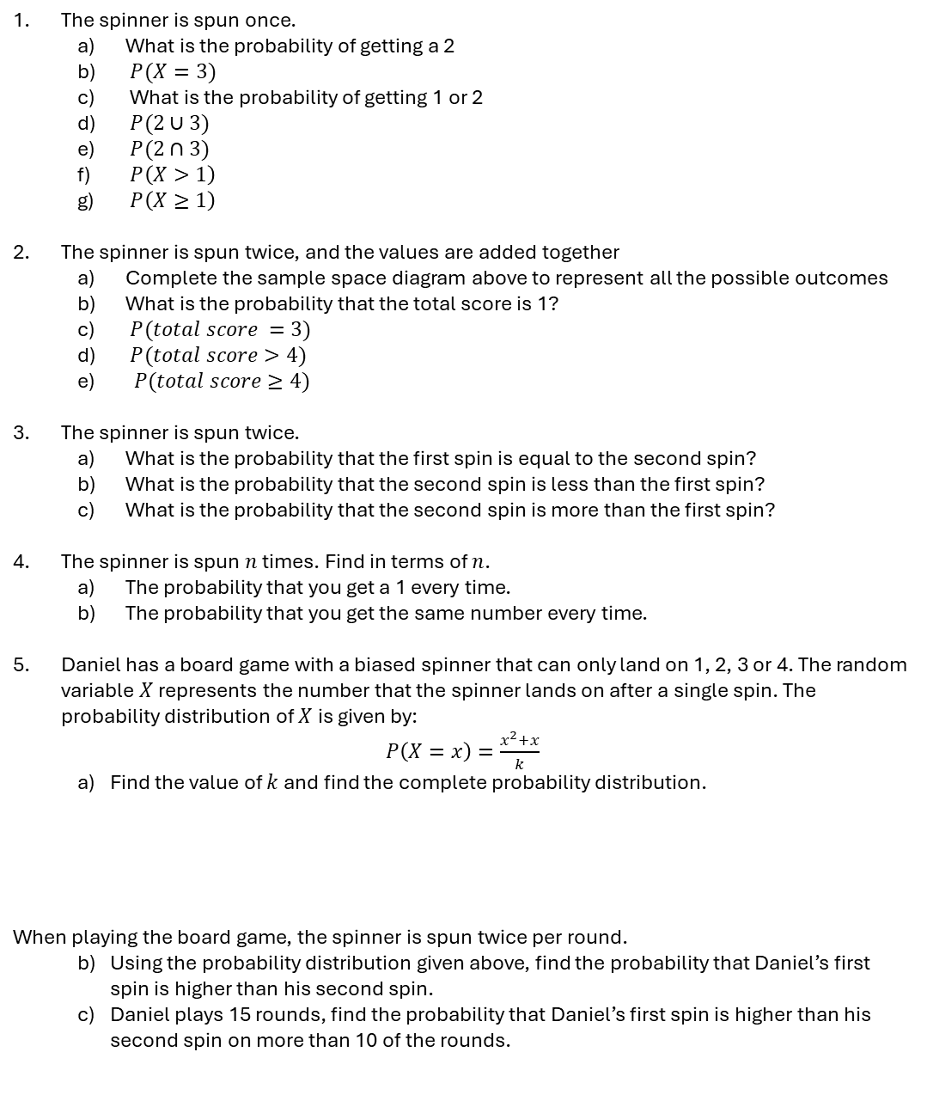
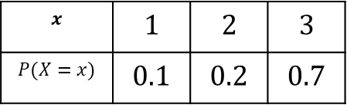
This table represents the probability distribution of a spinner
$$x$$ | $$1$$ | $$2$$ | $$3$$
$$P(X=x)$$ | $$0.1$$ | $$0.2$$ | $$0.7$$
The spinner is spun once.
  What is the probability of getting a 2
  $P(X=3)$
  What is the probability of getting 1 or 2
  $P(2∪3)$
  $P(2∩3)$
  $P\left(X>1\right)$
  $P\left(X≥1\right)$
The spinner is spun twice, and the values are added together
  Complete the sample space diagram above to represent all the possible outcomes
  What is the probability that the total score is 1?
  $P(total score =3)$
  $P(total score>4)$
  $P(total score≥4)$
The spinner is spun twice.
  What is the probability that the first spin is equal to the second spin?
  What is the probability that the second spin is less than the first spin?
  What is the probability that the second spin is more than the first spin?
The spinner is spun $n$ times. Find in terms of $n$.
  The probability that you get a 1 every time.
  The probability that you get the same number every time.
Daniel has a board game with a biased spinner that can only land on 1, 2, 3 or 4. The random variable $X$ represents the number that the spinner lands on after a single spin. The probability distribution of $X$ is given by:
$P\left(X=x\right)=\frac{x^{2}+x}{k}$
  Find the value of $k$ and find the complete probability distribution.
When playing the board game, the spinner is spun twice per round.
  Using the probability distribution given above, find the probability that Daniel’s first spin is higher than his second spin.
  Daniel plays 15 rounds, find the probability that Daniel’s first spin is higher than his second spin on more than 10 of the rounds.
 | First Spin
Second Spin |  | 1 | 2 | 3
 | 1
 | 2
 | 3

