Slide 1
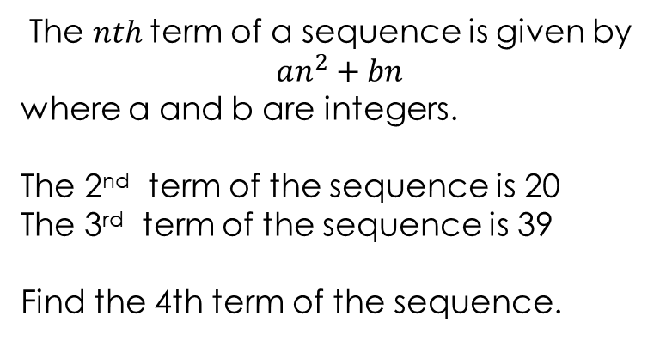
The $nth$term of a sequence is given by
$$an^{2}+bn$$
where a and b are integers.
The 2nd term of the sequence is 20
The 3rd term of the sequence is 39
Find the 4th term of the sequence.

Slide 2
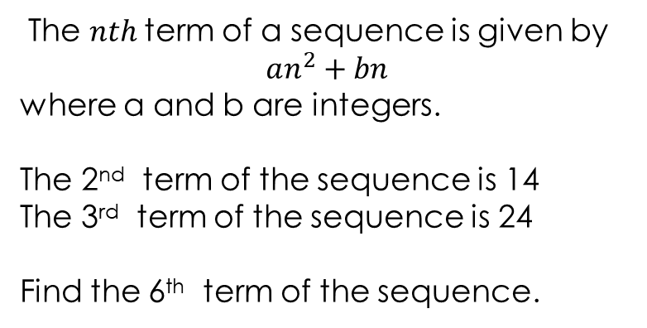
The $nth$term of a sequence is given by
$$an^{2}+bn$$
where a and b are integers.
The 2nd term of the sequence is 14
The 3rd term of the sequence is 24
Find the 6th term of the sequence.

Slide 3
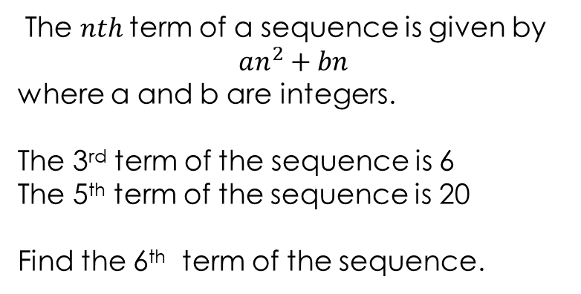
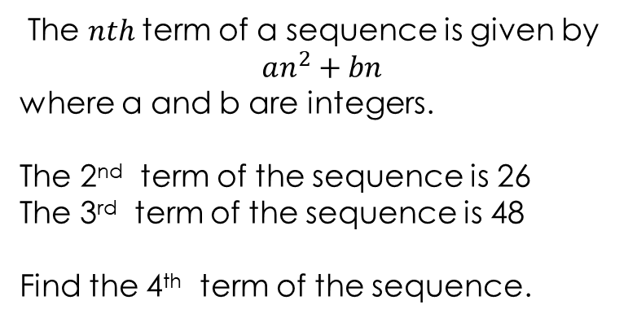
You do
The $nth$term of a sequence is given by
$$an^{2}+bn$$
where a and b are integers.
The 2nd term of the sequence is 26
The 3rd term of the sequence is 48
Find the 4th term of the sequence.
The $nth$term of a sequence is given by
$$an^{2}+bn$$
where a and b are integers.
The 3rd term of the sequence is 6
The 5th term of the sequence is 20
Find the 6th term of the sequence.

Slide 4
Sequences
The $nth$term of a sequence is given by $an^{2}+bn$ where $a$ and $b$ are integers.
Find the 10th term of each sequence
The 2nd term of the sequence is 10 The 3rd term of the sequence is 15 | The 5th term of the sequence is 15 The 3rd term of the sequence is 3
The 2nd term of the sequence is 4 The 3rd term of the sequence is 15 | The 2nd term of the sequence is 24 The 4th term of the sequence is 51

Slide 5
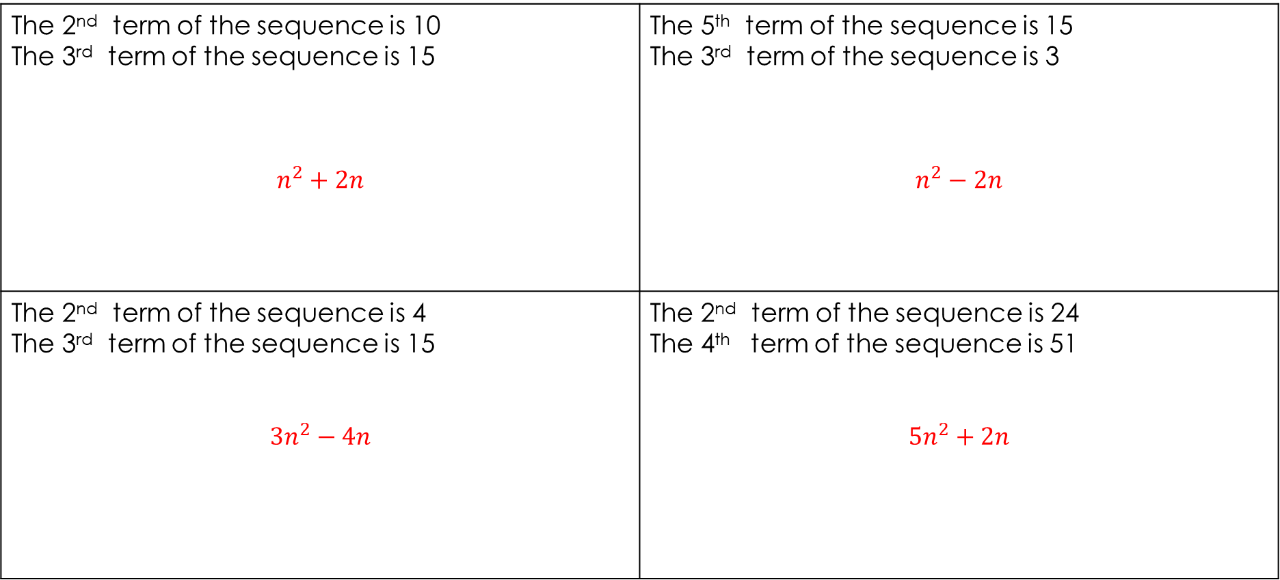
ANSWERS
The $nth$term of a sequence is given by $an^{2}+bn$ where $a$ and $b$ are integers.
Find the 10th term of each sequence
The 2nd term of the sequence is 10 The 3rd term of the sequence is 15 $$n^{2}+2n$$ | The 5th term of the sequence is 15 The 3rd term of the sequence is 3 $$n^{2}−2n$$
The 2nd term of the sequence is 4 The 3rd term of the sequence is 15 $$3n^{2}−4n$$ | The 2nd term of the sequence is 24 The 4th term of the sequence is 51 $$5n^{2}+2n$$

