Slide 1
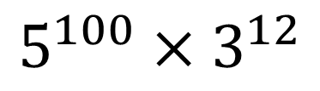

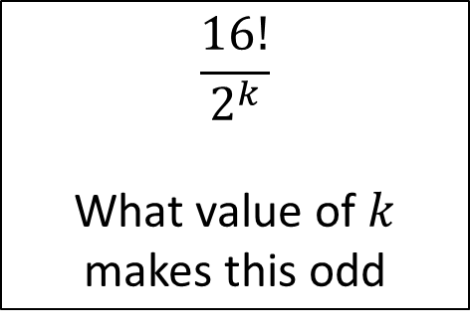

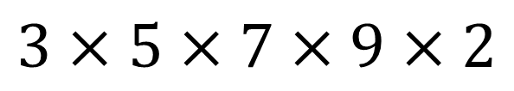




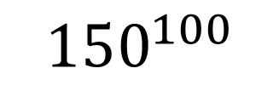
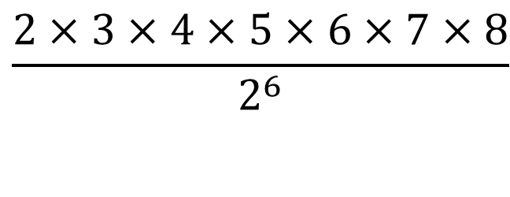
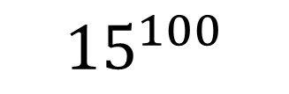

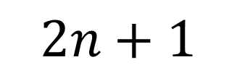
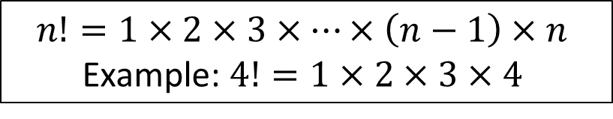
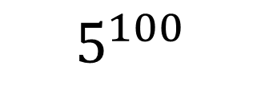


Odds or Evens
$$n!=1×2×3×…×\left(n−1\right)×n$$
Example: $4!=1×2×3×4$
Sort the following into odds and evens
$$5^{100}×3^{12}$$
$$5!$$
$$\frac{5!}{2}$$
$$2^{5}$$
$$\frac{5!}{4!}$$
$$2n$$
$$5^{2}$$
$$\frac{5!}{2^{3}}$$
$$2n+1$$
$$5^{100}$$
$$\frac{5!}{3!}$$
$$3×5×7×9×2$$
$${15}^{100}$$
$$\frac{16!}{2^{k}}$$
What value of $k$ makes this odd
$$\frac{10!}{10!}$$
$$\frac{2×3×4×5×6×7×8}{2^{6}}$$
$${150}^{100}$$

Slide 2
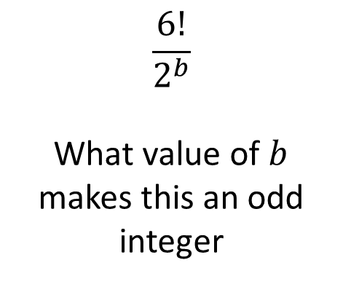
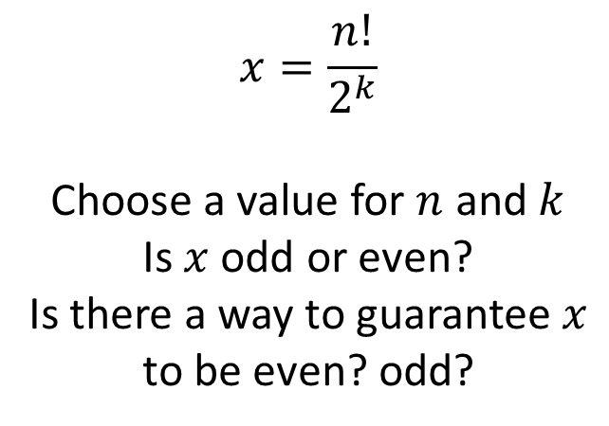
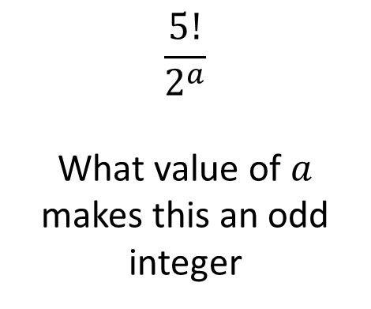
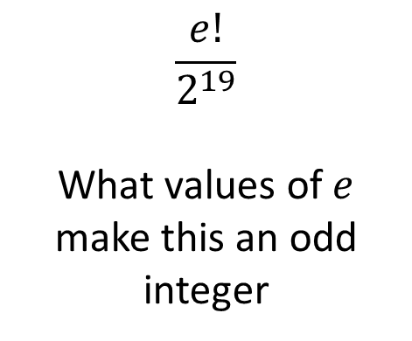
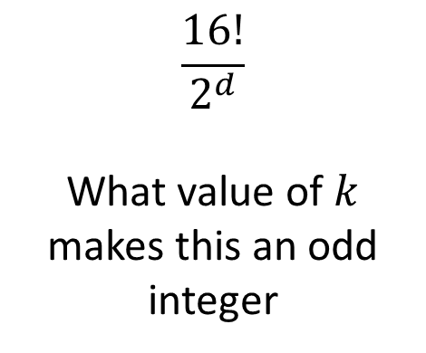
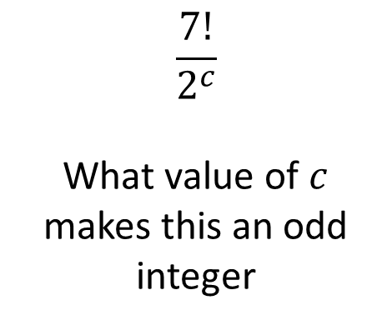
$$\frac{5!}{2^{a}}$$
What value of $a$ makes this an odd integer
$$\frac{6!}{2^{b}}$$
What value of $b$ makes this an odd integer
$$\frac{7!}{2^{c}}$$
What value of $c$ makes this an odd integer
$$\frac{16!}{2^{d}}$$
What value of $k$ makes this an odd integer
$$\frac{e!}{2^{19}}$$
What values of $e$ make this an odd integer
$$x=\frac{n!}{2^{k}}$$
Choose a value for $n$ and $k$
Is $x$ odd or even?
Is there a way to guarantee $x$ to be even? odd?

Slide 3






What is the last digit of the following numbers?
$$4!$$
$$5!$$
$$6!$$
$$7!$$
$$8!$$
What do you notice?
What about $100!$

Slide 4







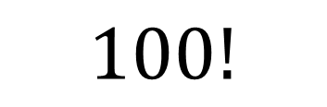
How many trailing zeroes are there?
$$5!$$
$$7!$$
$$10!$$
$$15!$$
What do you notice?
How many trailing zeroes are there?
$$25!$$
$$45!$$
$$50!$$
$$100!$$

