Slide 1
Starter
Write 10 questions getting students to practice
Rationalizing the denominator of surds
Write 10 questions getting students to practice
Finding cartesian equations from parametric equations
What are you thinking about whilst choosing the questions?
What are you thinking about whilst choosing the questions?

Slide 2
Variation Theory in
A Level Maths
Natan Lev and Shane Steele
@mrlevmaths.bsky.social
@mrsteele314.bsky.social

Slide 3
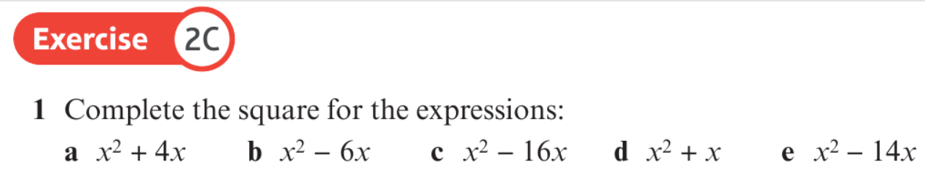
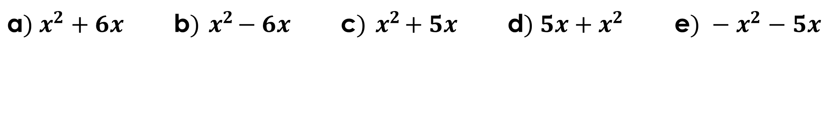
Fluency vs Variation Theory
Guess the exercise!
Complete the square for the expressions:
a$) x^{2}+6x$ | b$){ x}^{2}−6x$ | c$){ x}^{2}+5x$ | d$) 5x+x^{2}$ | e$) −x^{2}−5x$
What could the next question be?

Slide 4
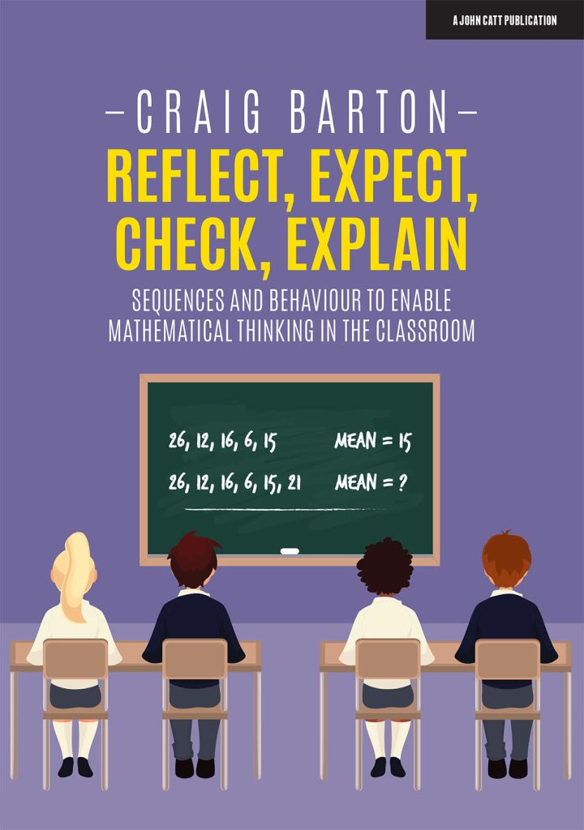
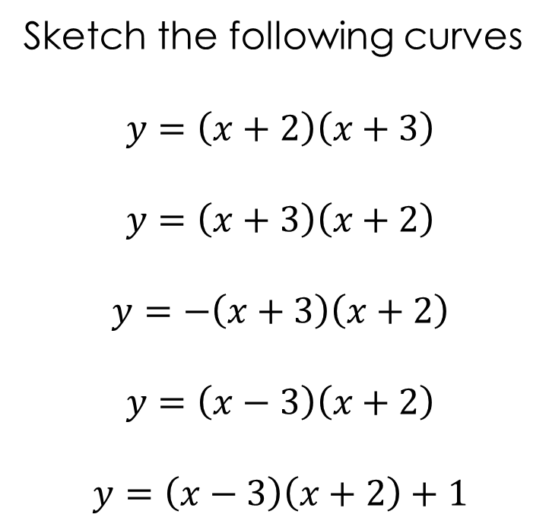
Brief VT History
What has changed?
What do you NOTICE
How is that going to affect my answer?
Let’s check my hypothesis
Explain what happened
Sketch the following curves
$$y=\left(x+2\right)\left(x+3\right)$$
$$y=\left(x+3\right)\left(x+2\right)$$
$$y=−\left(x+3\right)\left(x+2\right)$$
$$y=\left(x−3\right)\left(x+2\right)$$
$$y=\left(x−3\right)\left(x+2\right)+1$$

Slide 5
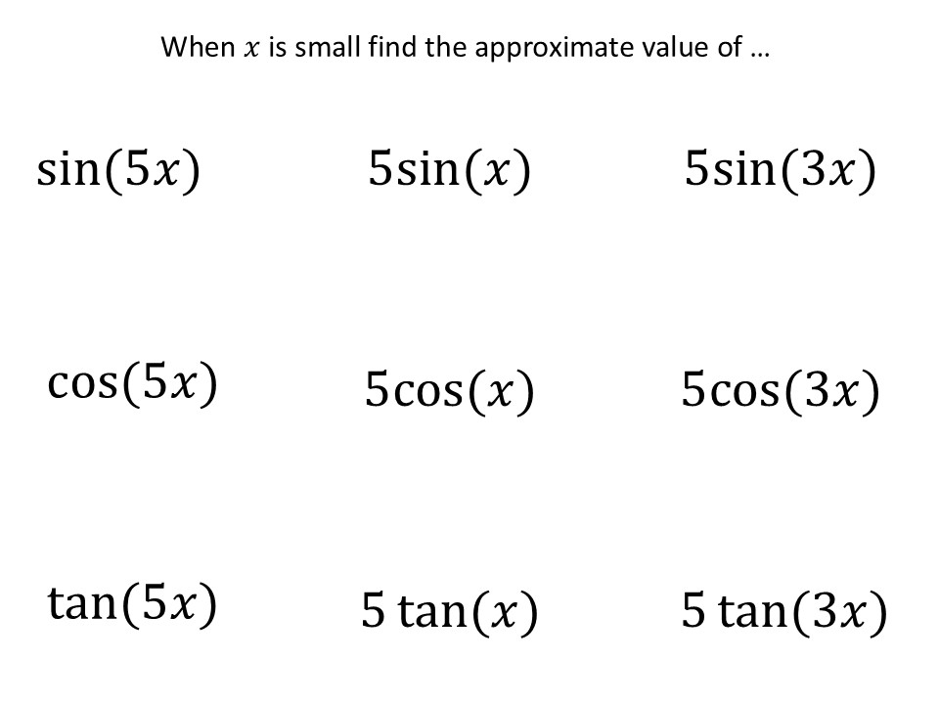
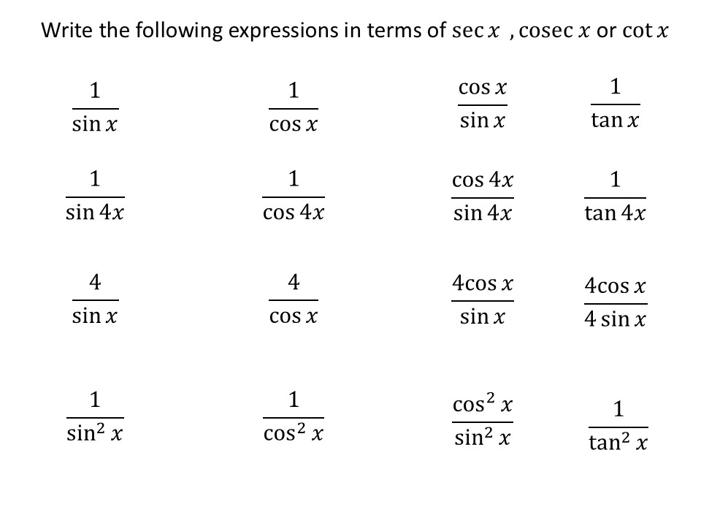
Some Examples
Reflect Expect Check Explain

Slide 6
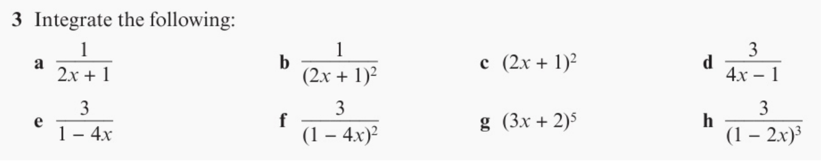
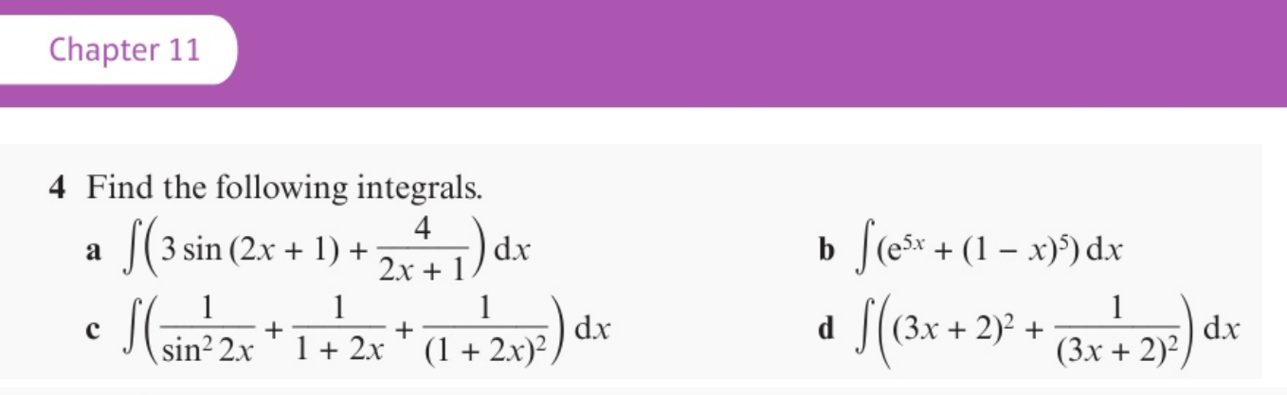
A Textbook Example!
Guess the Chapter!

Slide 7
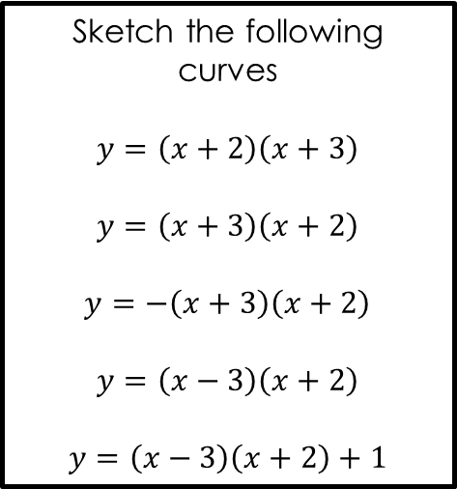
Benefits
For the writer
Helps add structure to planning and actually makes it easier to think of questions
You can plan for students to see each misconception
Writing sequences of questions is good CPD
"What are the problems I am anticipating...“
Fun to do!
“Self Differentiates”
Sketch the following curves
$$y=\left(x+2\right)\left(x+3\right)$$
$$y=\left(x+3\right)\left(x+2\right)$$
$$y=−\left(x+3\right)\left(x+2\right)$$
$$y=\left(x−3\right)\left(x+2\right)$$
$$y=\left(x−3\right)\left(x+2\right)+1$$
For the do-er
Encourages mathematical thinking
Reflect, Expect, Check, Explain
Fun to notice connections and make predictions

Slide 8
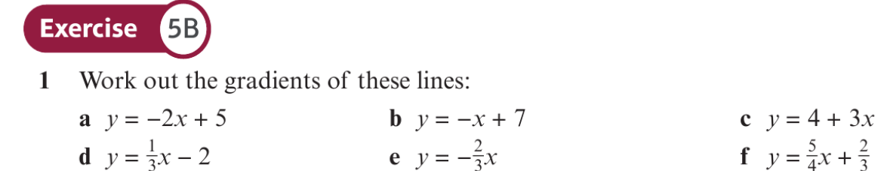

Fluency vs Variation
Guess the exercise!
What do we want students to be practicing?
What do we want to check students know how to do?
$$y=2x+3$$
What are the next few questions in the sequence?

Slide 9
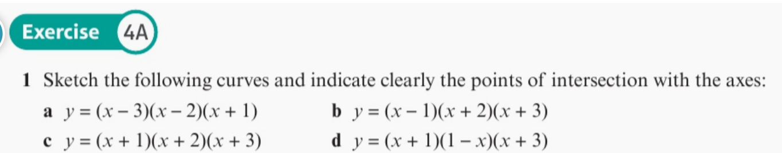

What could the next questions be?
Guess the exercise!
$$y=(x−3)(x−2)(x+1)$$

Slide 10
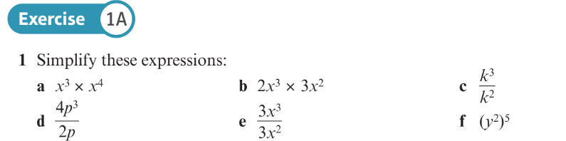
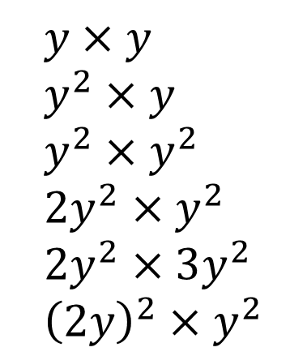
What could the next questions be?
Guess the exercise!
$$y×y \\ y^{2}×y \\ y^{2}×y^{2} \\ 2y^{2}×y^{2} \\ 2y^{2}×3y^{2} \\ {\left(2y\right)}^{2}×y^{2}$$
What would the next five questions be?
Compare with your neighbour, what was the same, what was different?
What did you think about whilst writing them?

Slide 11
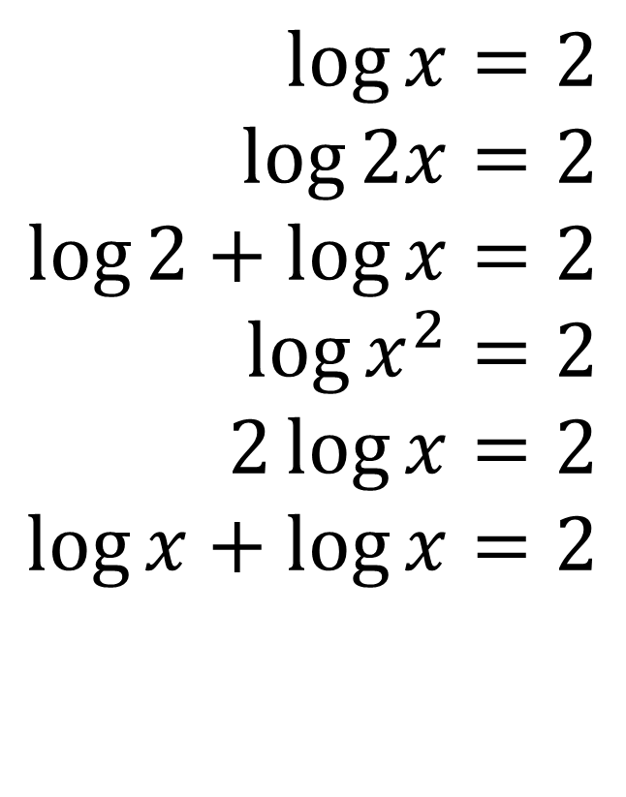
What could the next questions be?
$$\log{x}=2 \\ \log{2x}=2 \\ \log{2}+\log{x}=2 \\ \log{x^{2}}=2 \\ 2\log{x}=2 \\ \log{x}+\log{x}=2$$
What would the next five questions be?
Compare with your neighbour, what was the same, what was different?
What did you think about whilst writing them?
Reflect Expect Check Explain

Slide 12
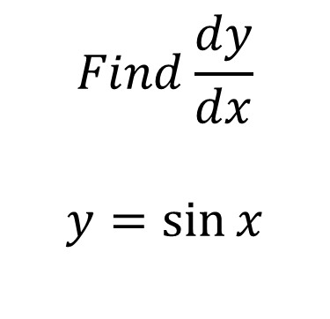
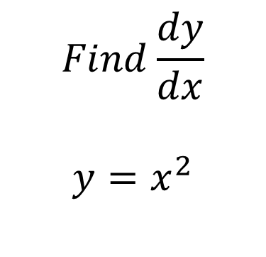
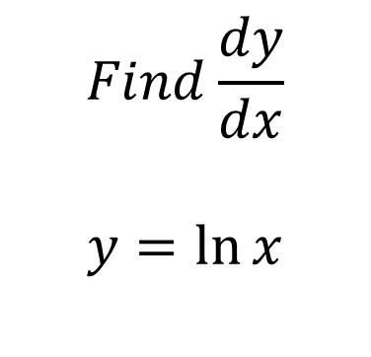
Continue these series of questions
$$Find\frac{dy}{dx}$$
$$y=x^{2}$$
$$Find\frac{dy}{dx}$$
$$y=\sin{x}$$
$$Find\frac{dy}{dx}$$
$$y=\ln{x}$$
Reflect Expect Check Explain

Slide 13
Choose any Topic – Lets do it live!
Let’s choose any topic, think of a starter question and then make a series of questions together

Slide 14
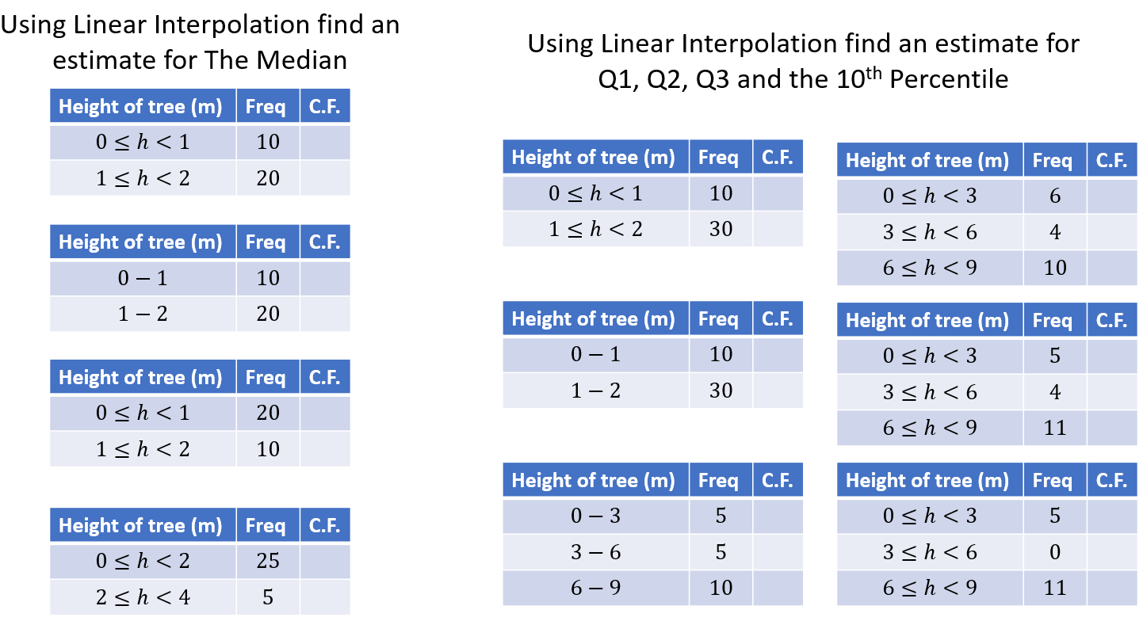

Slide 15
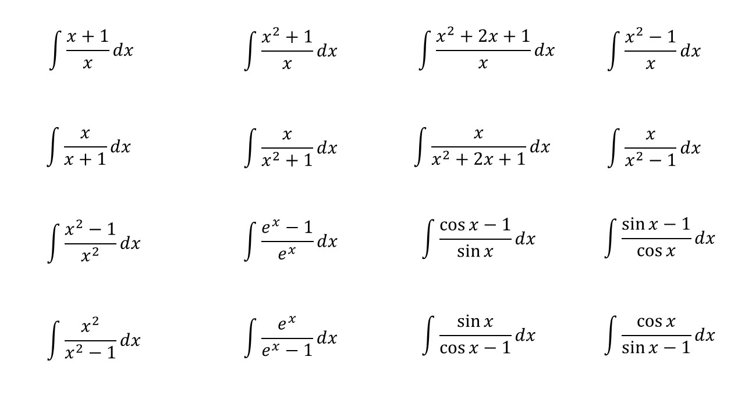
Extra Examples

Slide 16
