Slide 1
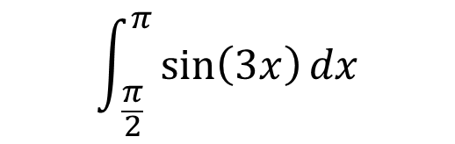
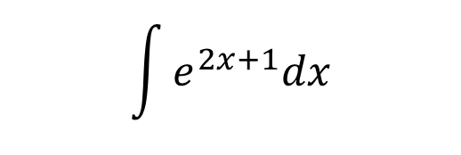
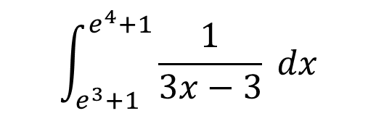
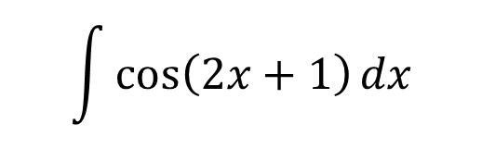
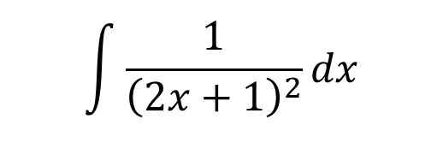
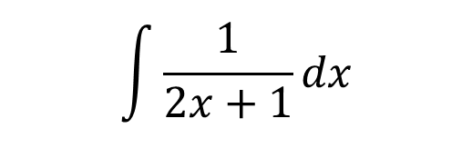
Integrate the following using reverse chain rule
$$\int{\cos\left(2x+1\right)dx}$$
$$\int{e^{2x+1}dx}$$
$$\int{\frac{1}{2x+1}dx}$$
$$\int{\frac{1}{{\left(2x+1\right)}^{2}}dx}$$
Now integrate them using the substitution $u=2x+1$
Integrate the following using reverse chain rule
$$\int_{ \frac{π}{2}}^{π}{\sin\left(3x\right)dx}$$
$$\int_{e^{3}+1}^{e^{4}+1}{\frac{1}{3x−3} dx}$$
Now integrate them using a substitution of your choice

Slide 2
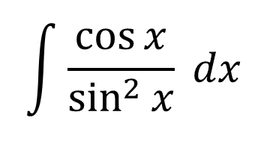
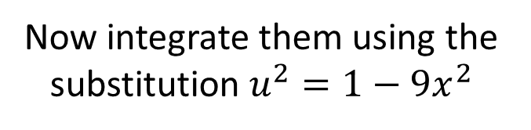
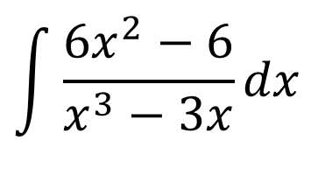

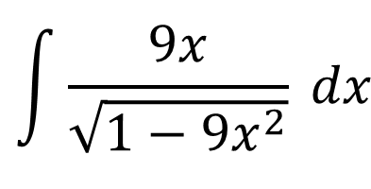
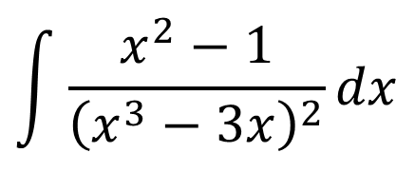
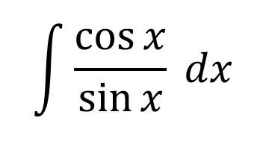
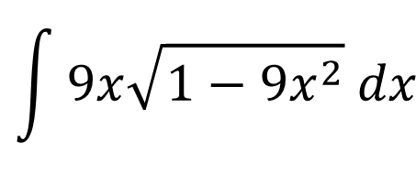
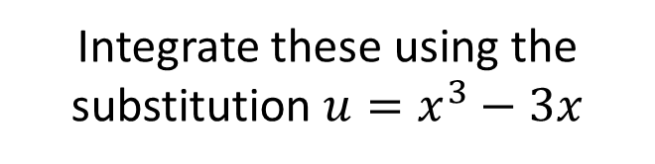
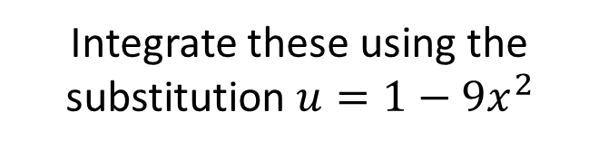
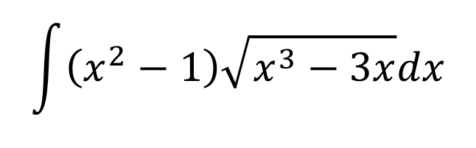
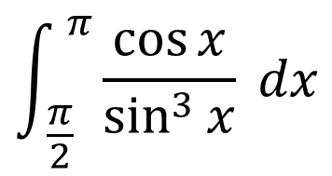
Integrate these using the substitution $u=x^{3}−3x$
Integrate these using the substitution $u=\sin{x}$
Integrate these using the substitution $u=1−9x^{2}$
$$\int{\frac{x^{2}−1}{{\left(x^{3}−3x\right)}^{2}}dx}$$
$$\int{\frac{\cos{x}}{\sin{x}} dx}$$
$$\int{9x\sqrt{1−9x^{2}} dx}$$
$$\int{\frac{9x}{\sqrt{1−9x^{2}}} dx}$$
$$\int{\frac{{6x}^{2}−6}{x^{3}−3x}dx}$$
$$\int{\frac{\cos{x}}{\sin^{2}{x}} dx}$$
Now integrate them using the substitution $u^{2}=1−9x^{2}$
$$\int{\left(x^{2}−1\right)\sqrt{x^{3}−3x}dx}$$
$$\int_{ \frac{π}{2}}^{ π}{\frac{\cos{x}}{\sin^{3}{x}}} dx$$
Integrals taken from Underground maths

Slide 3


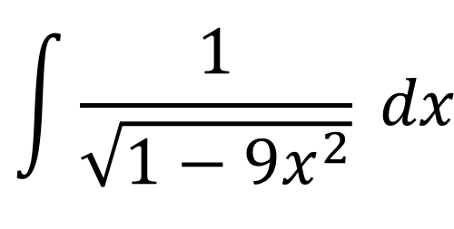
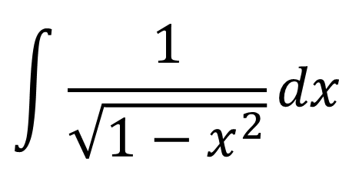



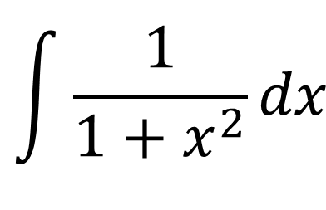

Integrate the following using the given trig substitutions
$$\int{\frac{1}{\sqrt{1−x^{2}}}dx}$$
$$\int{\frac{1}{1+x^{2}}dx}$$
$$\int{\frac{1}{\sqrt{1−9x^{2}}} dx}$$
$$x=\sin{u}$$
$$x=\tan{u}$$
$$3x=\sin{u}$$
$$x=\sin{u}$$
$$x=\cos{u}$$
$$x=\cos{u}$$

Slide 4


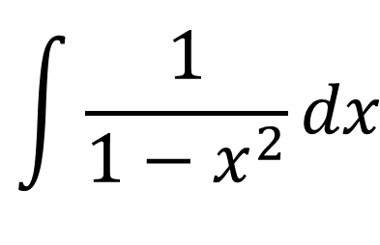
Harder: Integrate the following using the given trig substitutions
$$\int{\frac{1}{1−x^{2}}dx}$$
$$x=\sin{u}$$
$$x=\cos{u}$$

