Slide 1
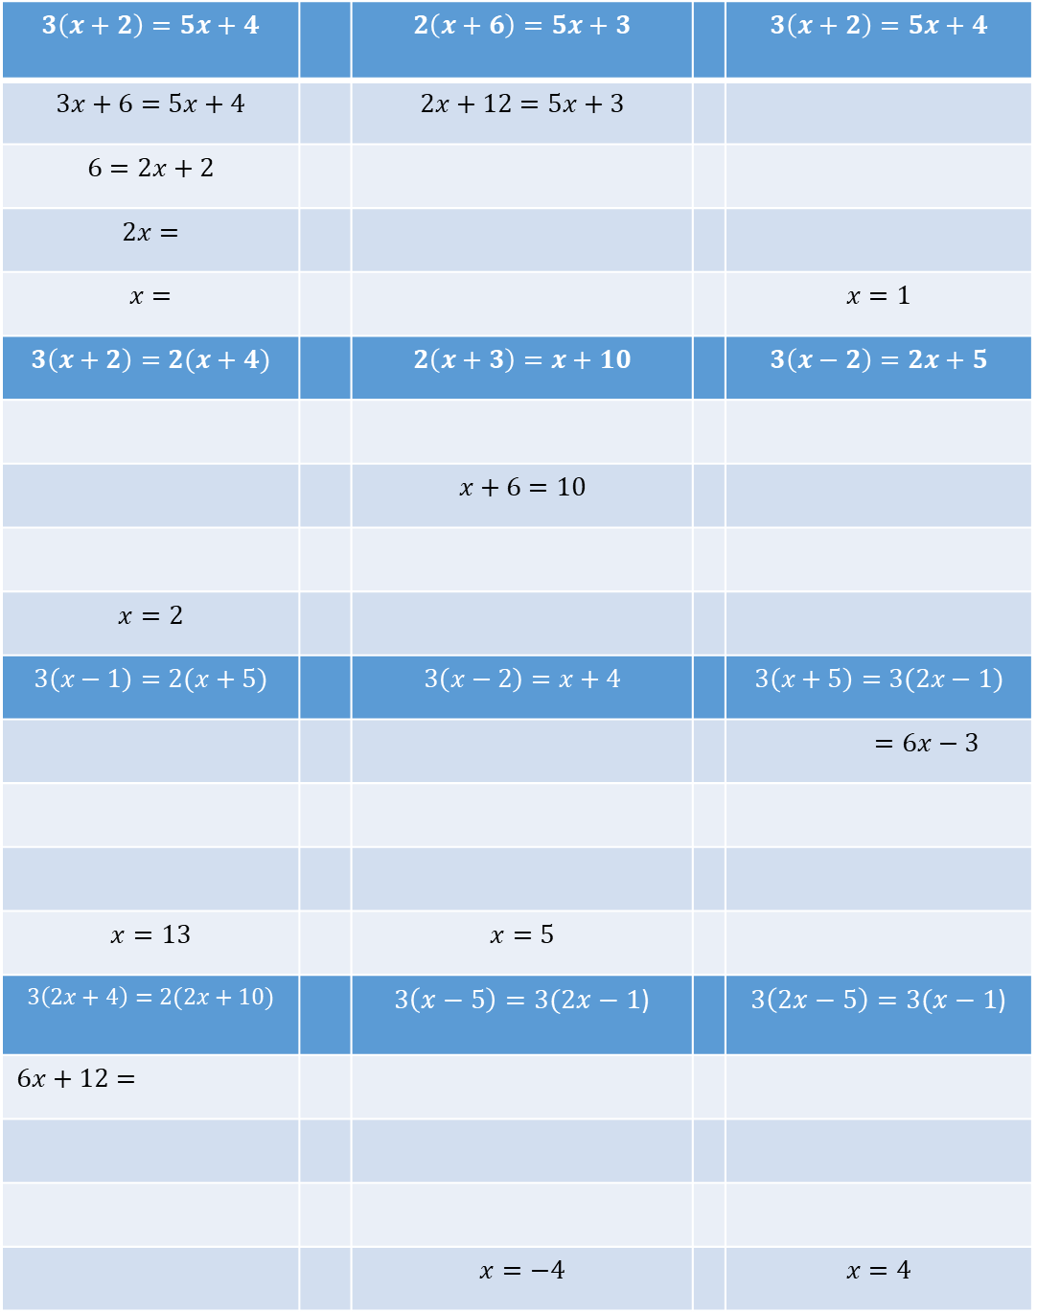
Fill in the missing gaps to solve each equation
$$3\left(x+2\right)=5x+4$$ |  | $$2\left(x+6\right)=5x+3$$ |  | $$3\left(x+2\right)=5x+4$$
$$3x+6=5x+4$$ |  | $$2x+12=5x+3$$
$$6=2x+2$$
$$2x=$$
$$x=$$ |  |  |  | $$x=1$$
$$3\left(x+2\right)=2(x+4)$$ |  | $$2\left(x+3\right)=x+10$$ |  | $$3\left(x−2\right)=2x+5$$
 |  | $$x+6=10$$
$$x=2$$
$$3\left(x−1\right)=2(x+5)$$ |  | $$3\left(x−2\right)=x+4$$ |  | $$3\left(x+5\right)=3(2x−1)$$
 |  |  |  | $$=6x−3$$
$$x=13$$ |  | $$x=5$$
$$3\left(2x+4\right)=2(2x+10)$$ |  | $3\left(x−5\right)=3(2x−1$) |  | $3\left(2x−5\right)=3(x−1$)
$$6x+12=$$
 |  | $$x=−4$$ |  | $$x=4$$

