Slide 1
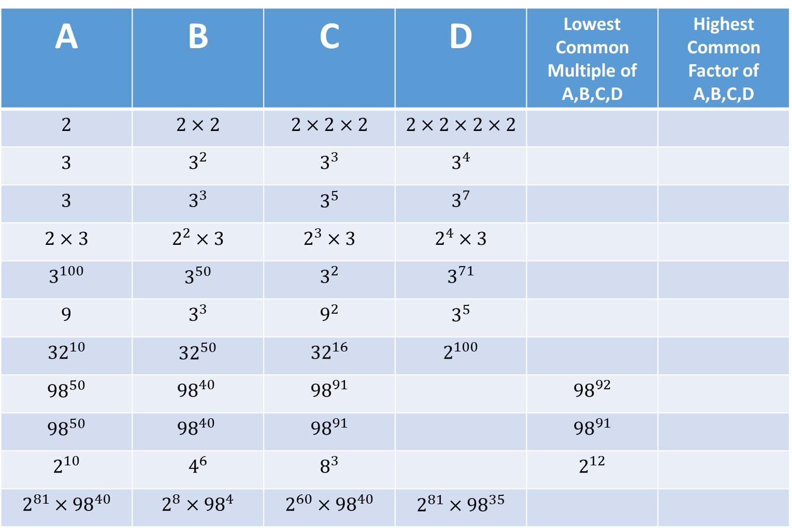
A | B | C | D | Lowest Common Multiple of A,B,C,D | Highest Common Factor of A,B,C,D
$$2$$ | $$2×2$$ | $$2×2×2$$ | $$2×2×2×2$$
$$3$$ | $$3^{2}$$ | $$3^{3}$$ | $$3^{4}$$
$$3$$ | $$3^{3}$$ | $$3^{5}$$ | $$3^{7}$$
$$2×3$$ | $$2^{2}×3$$ | $$2^{3}×3$$ | $$2^{4}×3$$
$$3^{100}$$ | $$3^{50}$$ | $$3^{2}$$ | $$3^{71}$$
$$9$$ | $$3^{3}$$ | $$9^{2}$$ | $$3^{5}$$
$${32}^{10}$$ | $${32}^{50}$$ | $${32}^{16}$$ | $$2^{100}$$
$${98}^{50}$$ | $${98}^{40 }$$ | $${98}^{91}$$ |  | $${98}^{92}$$
$${98}^{50}$$ | $${98}^{40 }$$ | $${98}^{91}$$ |  | $${98}^{91}$$
$$2^{10}$$ | $$4^{6}$$ | $$8^{3}$$ |  | $$2^{12}$$
$$2^{81}×{98}^{40}$$ | $$2^{8}×{98}^{4}$$ | $$2^{60}×{98}^{40}$$ | $$2^{81}×{98}^{35}$$

