Slide 1
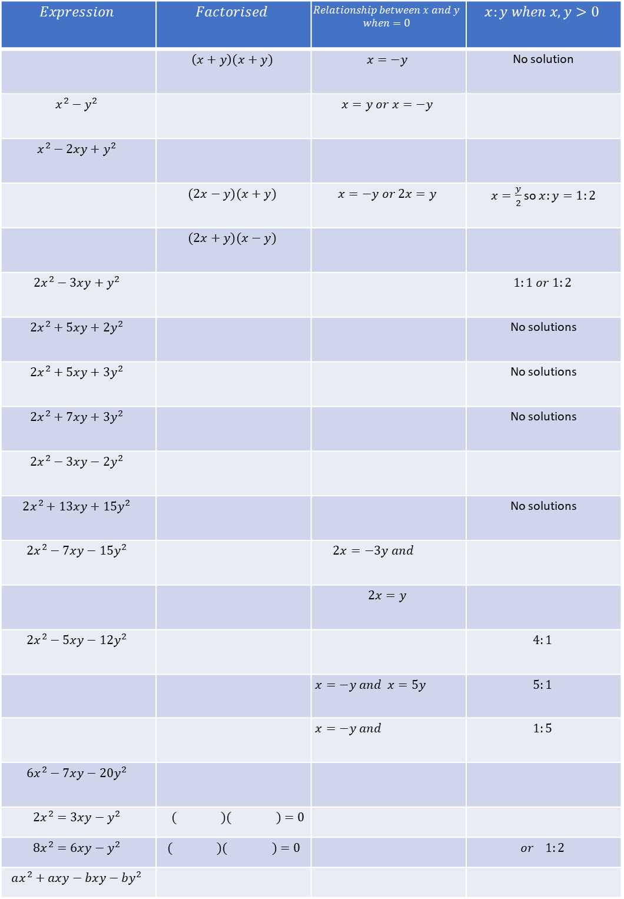
$$Expression$$ | $$Factorised$$ | $$Relationship between x and y$$ $$when=0$$ | $$x:y when x,y>0$$
 | $$\left(x+y\right)(x+y)$$ | $$x=−y$$ | No solution
$$x^{2}−y^{2}$$ |  | $$x=y or x=−y$$
$$x^{2}−2xy+y^{2}$$
 | $$(2x−y)(x+y)$$ | $$x=−y or 2x=y$$ | $x=\frac{y}{2}$ so $x:y=1:2$
 | $$(2x+y)(x−y)$$
$$2x^{2}−3xy+y^{2}$$ |  |  | $$1:1 or 1:2$$
$$2x^{2}+5xy+2y^{2}$$ |  |  | No solutions
$$2x^{2}+5xy+3y^{2}$$ |  |  | No solutions
$$2x^{2}+7xy+3y^{2}$$ |  |  | No solutions
$$2x^{2}−3xy−2y^{2}$$
$$2x^{2}+13xy+15y^{2}$$ |  |  | No solutions
$$2x^{2}−7xy−15y^{2}$$ |  | $$2x=−3y and$$
 |  | $$2x=y$$
$$2x^{2}−5xy−12y^{2}$$ |  |  | $$4:1$$
 |  | $$x=−y and x=5y$$ | $$5:1$$
 |  | $$x=−y and$$ | $$1:5$$
$$6x^{2}−7xy−20y^{2}$$
$$2x^{2}=3xy−y^{2}$$ | $$( )( )=0$$
$$8x^{2}=6xy−y^{2}$$ | $$( )( )=0$$ |  | $$or 1:2$$
$$ax^{2}+axy−bxy−by^{2}$$

